Slide 1

COVID19

Slide 2
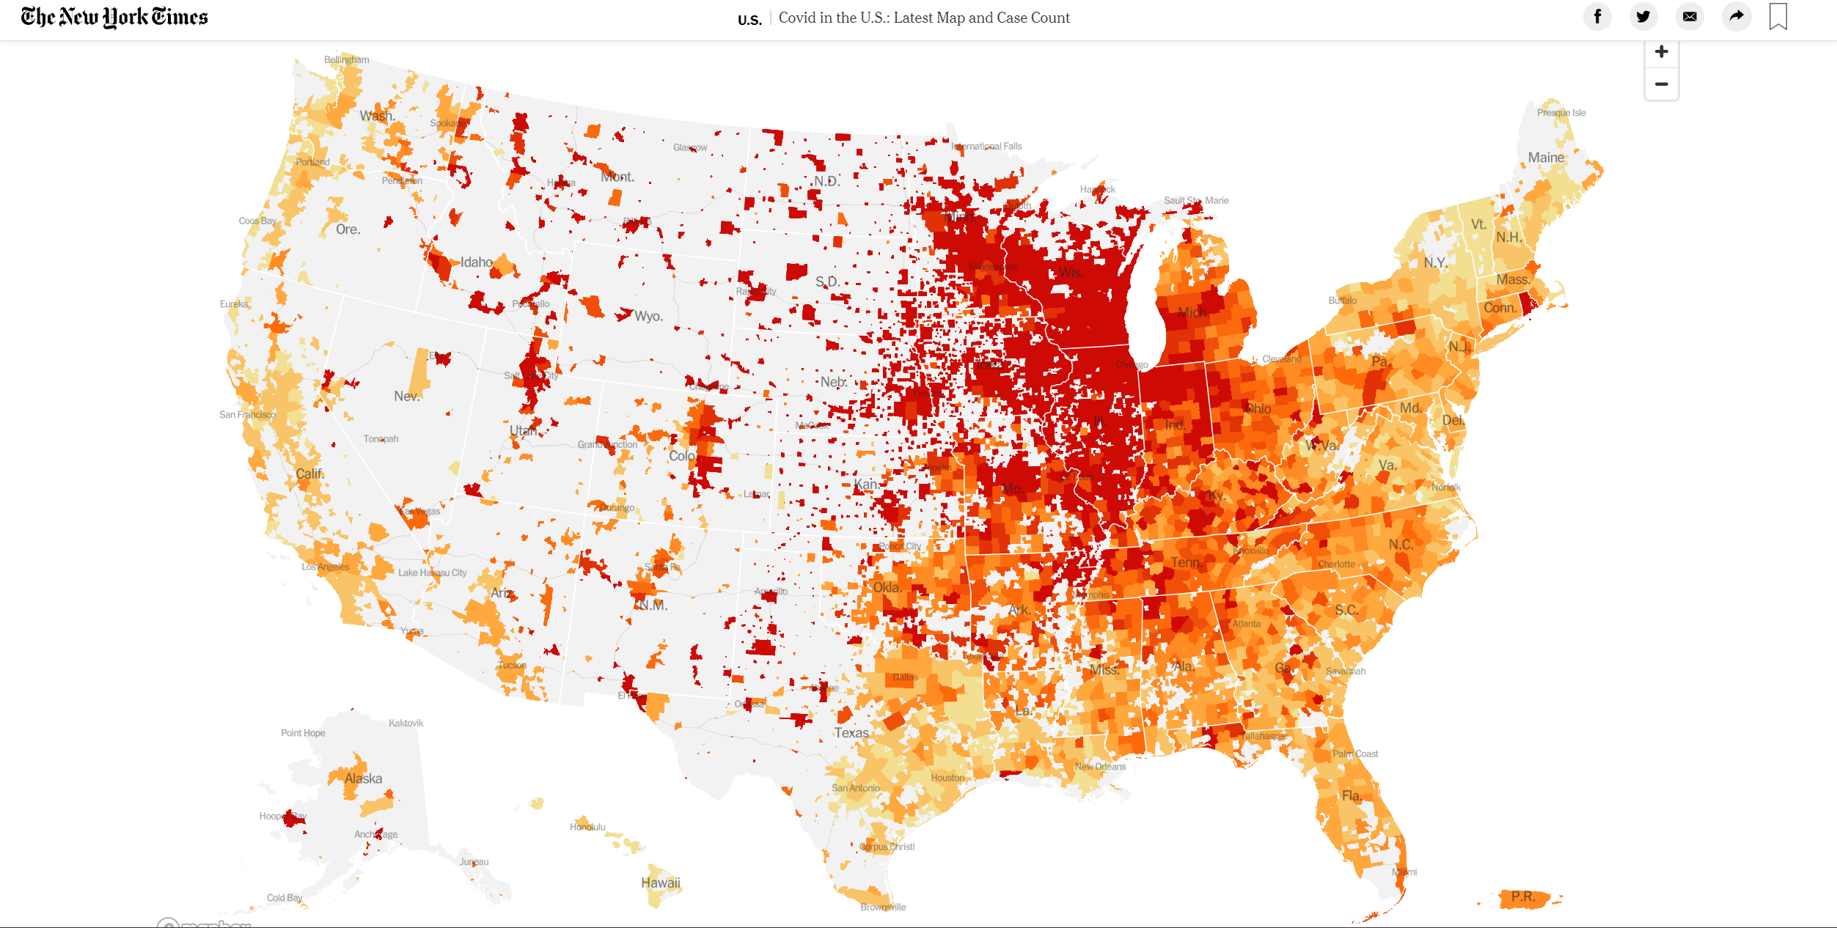

Slide 3


Do rates of covid19 differ based on local policies implemented?
Comparison between California and Texas

Slide 4
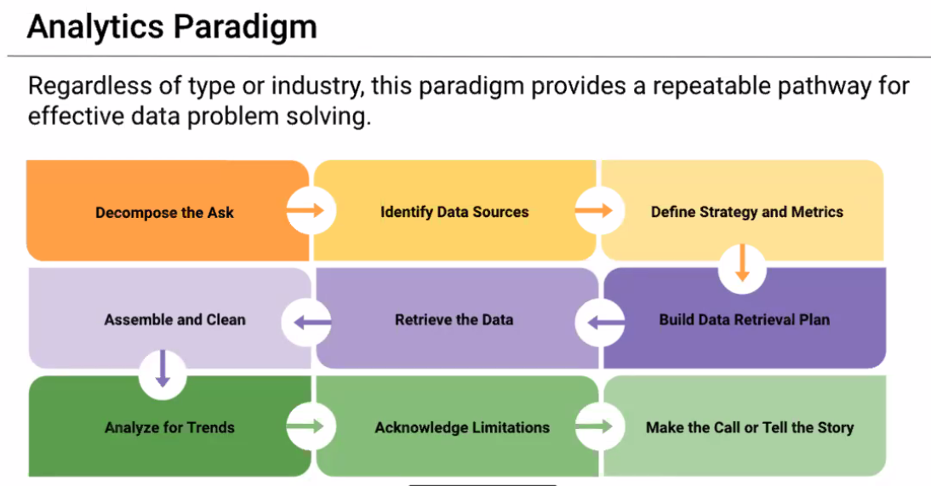

Slide 5
Resources
John Hopkins University Covid19 data
NY Times
CA and TX Health Government websites (policy implementation)

Slide 6
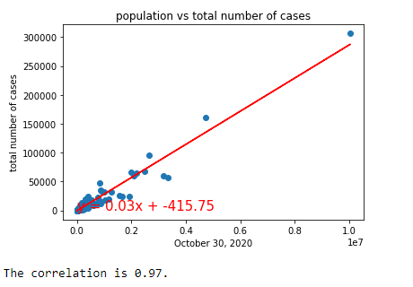
Exploratory data visualization
CA and TX population plotted together against cumulative Covid19 cases by 10/30/2020

Slide 7
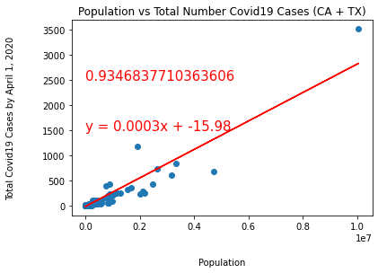
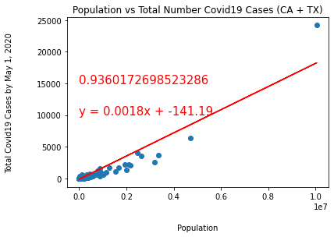
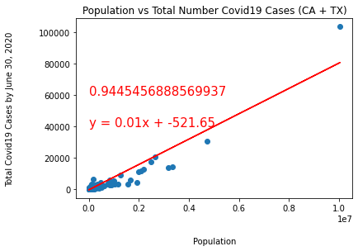
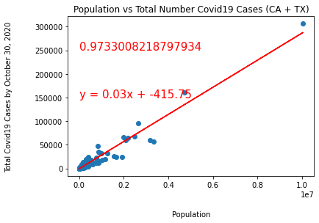
CA and TX population plotted together against cumulative Covid19 cases by Dates
April 1,2020
May 1,2020
June 30,2020
October 30,2020

Slide 8
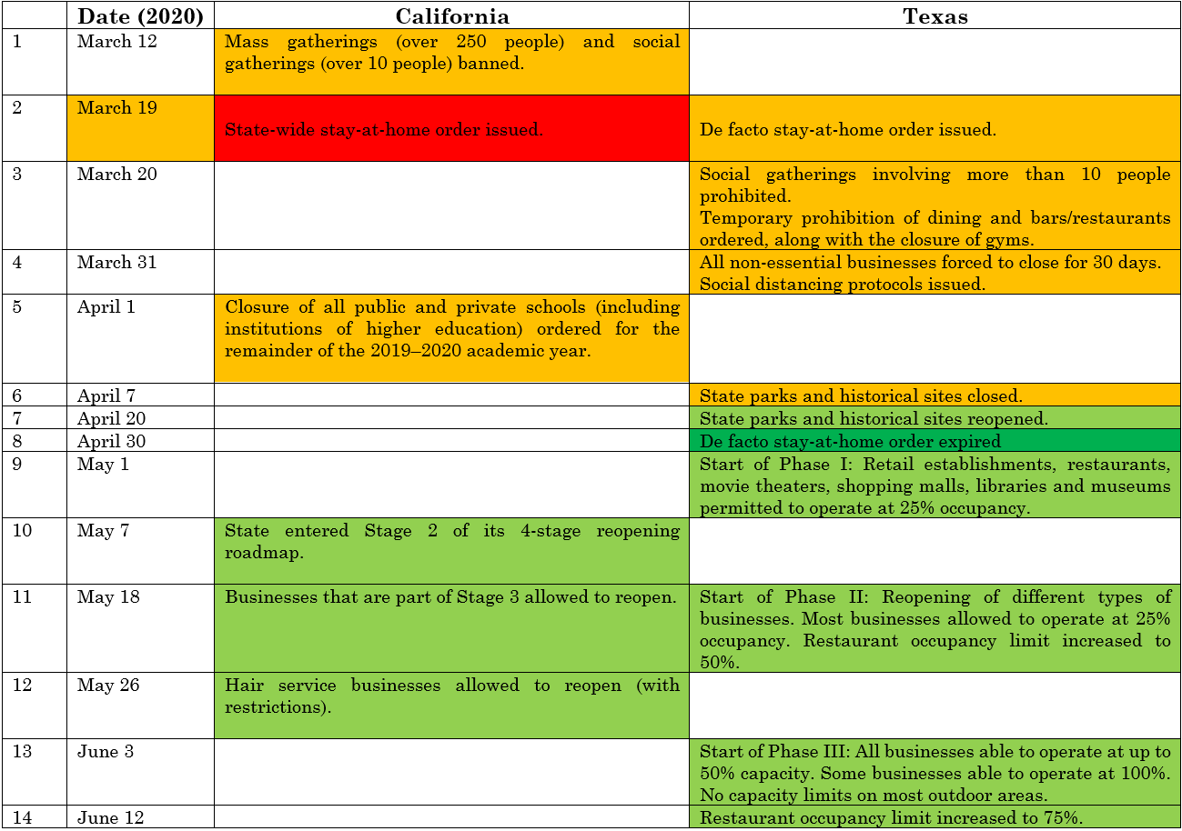

Slide 9
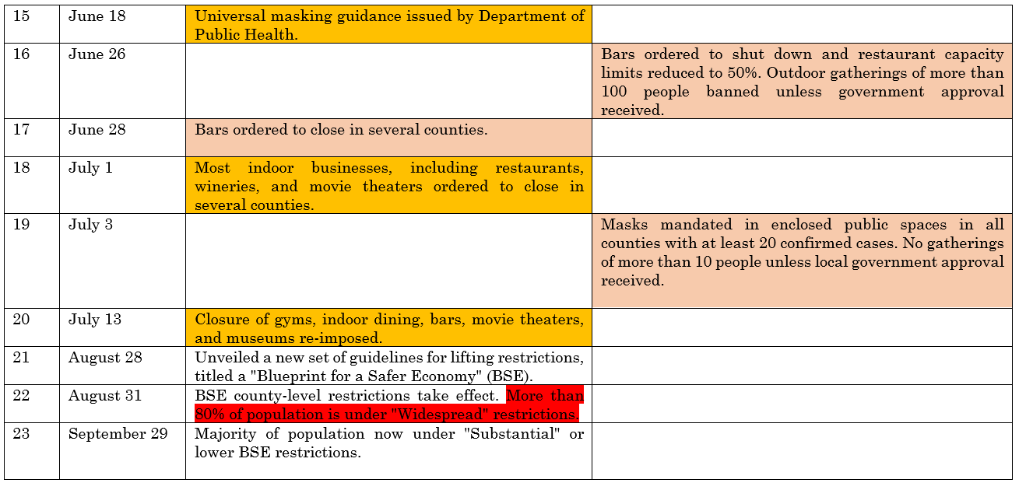

Slide 10
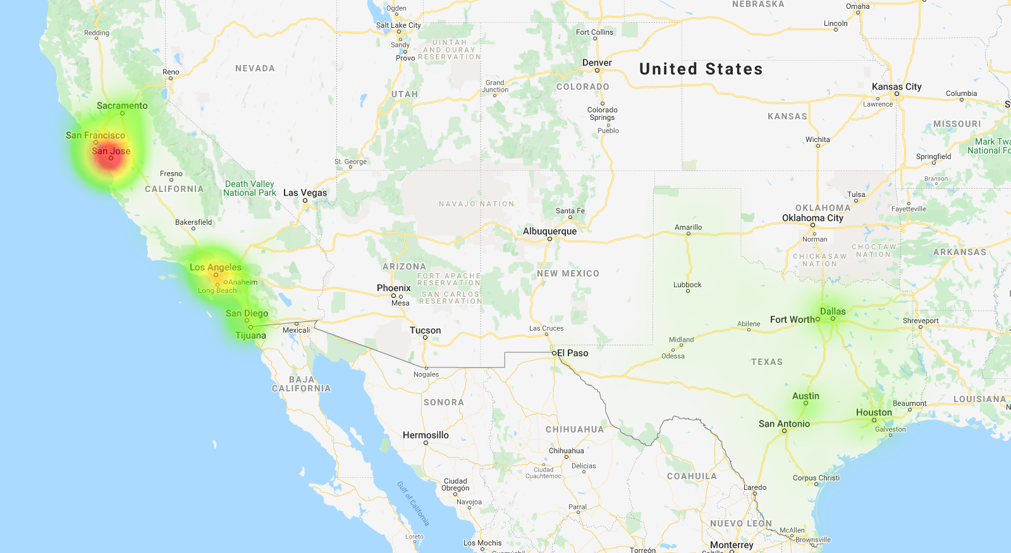

March 18, 2020

Slide 11
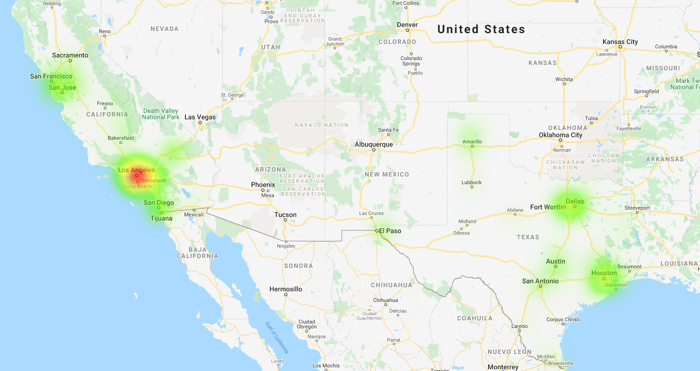
April 29, 2020

Slide 12
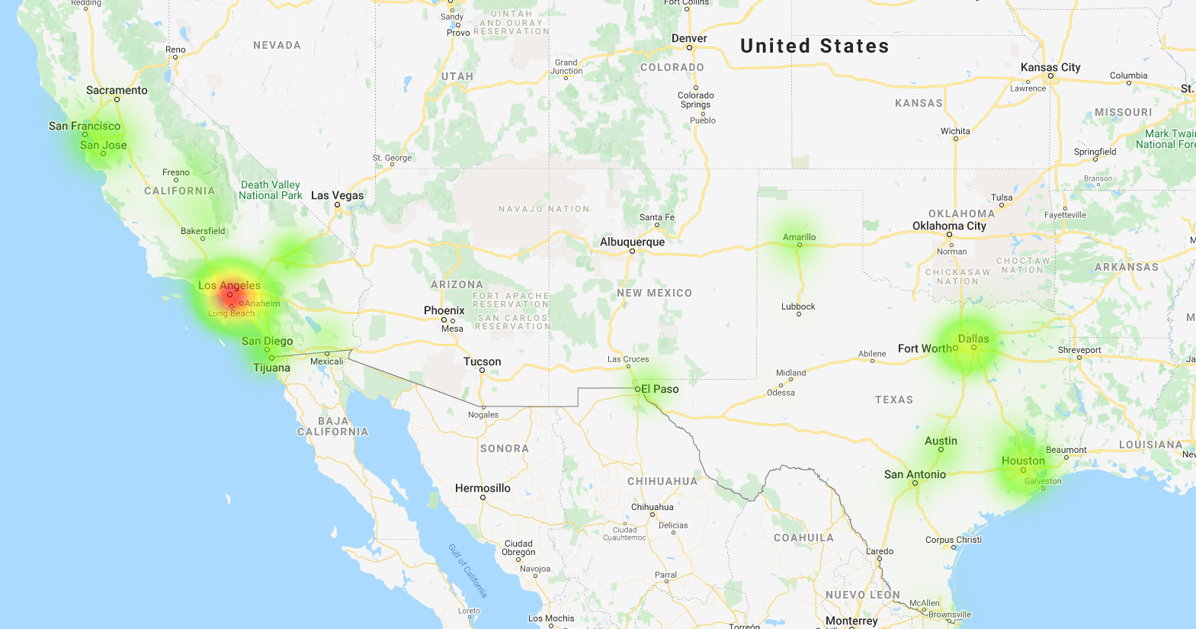
May 27, 2020

Slide 13
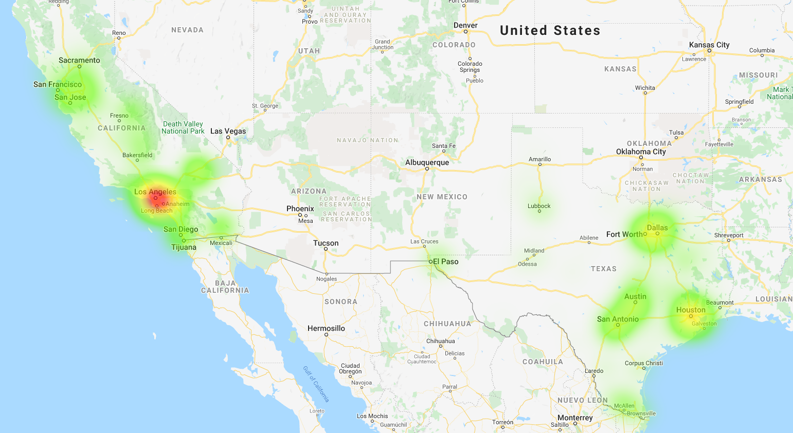
June 24, 2020

Slide 14
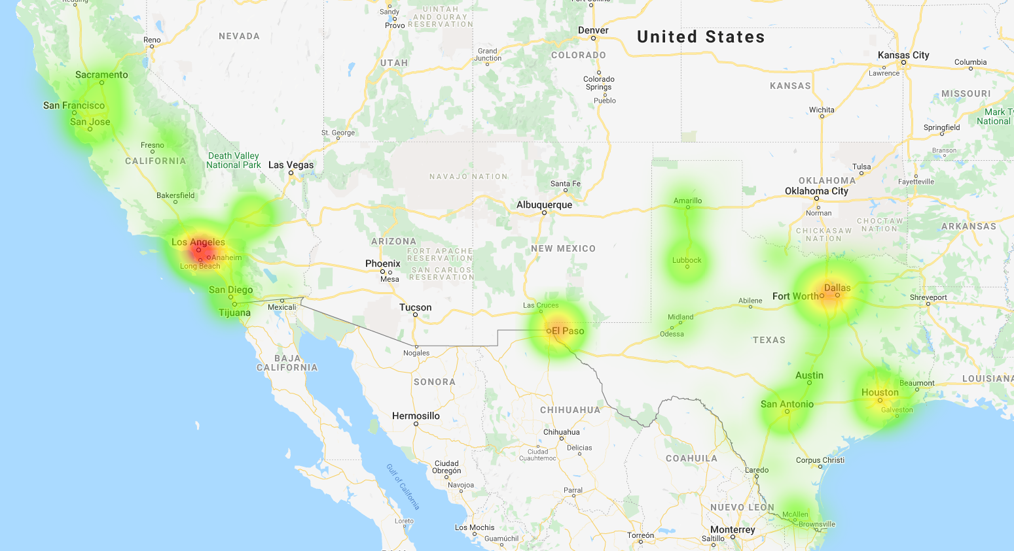
October 28, 2020

Slide 15
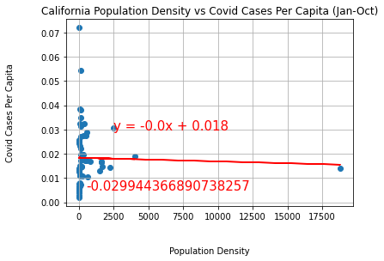
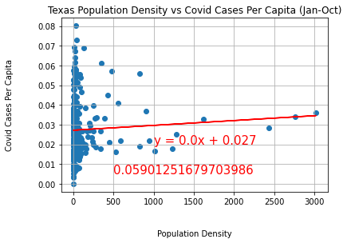
State | Population | Difference in Population | Land Area(Sq. Mi.) | Difference in Land Area | Population Density
CA | 37,332,138 | CA 8.3 million more | 155,779 | TX 105K Sq. Mi. more | 0.0042
TX | 28,995,881 |  | 261,267 |  | 0.009
San Francisco

Slide 16
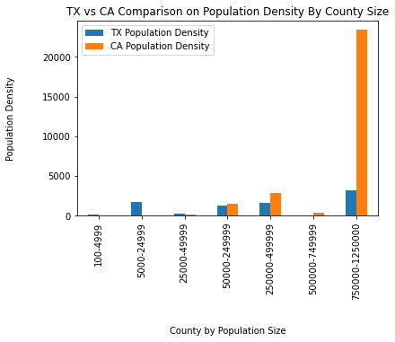
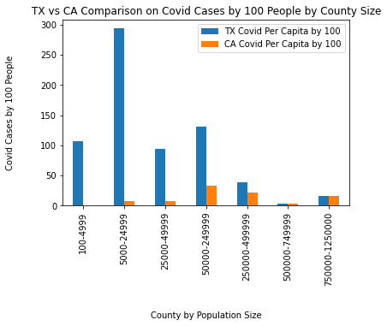
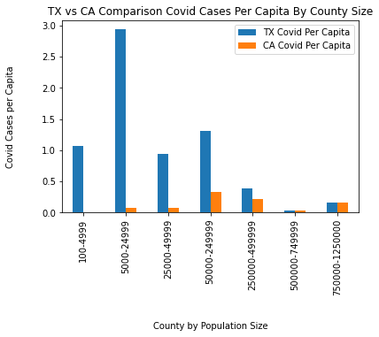
Counties by Population Size
Rural
Urban
Rural
Urban

Slide 17
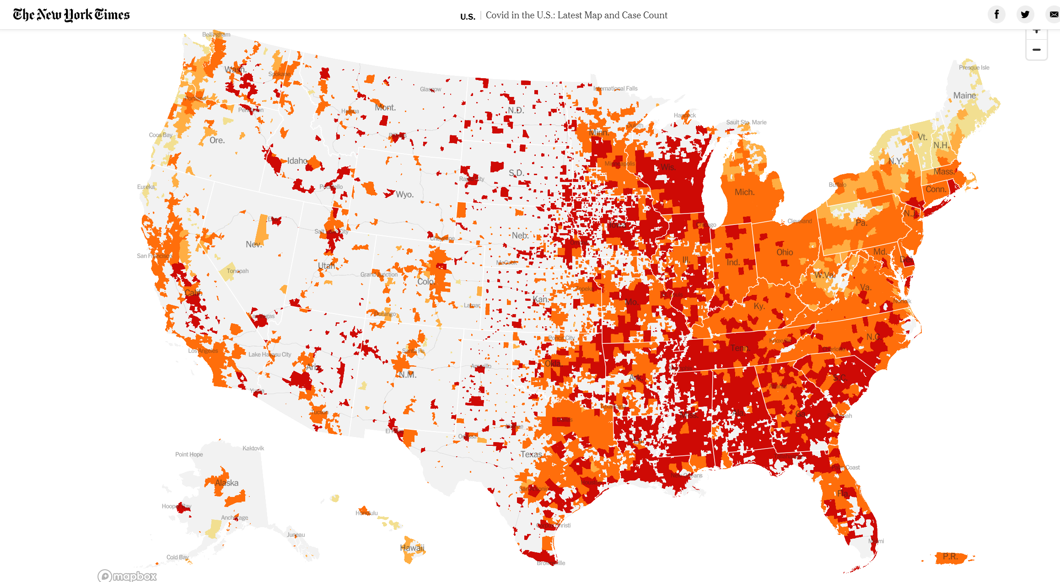
Codic19 Cases Per Capita, 11/8/2020

Slide 18
Limitations

Slide 19
Things we would do different next time

